Slide 1
Family Orientation Summer 2020

Slide 2
WELCOME FAMILIES
Optimal Zoom Settings
Live Chat Feature
Fall 2020 Planning & Guiding Principles

Slide 3
Fall 2020 Guiding Principles
Our top priority is safety of our students and employees, as guided by the CDC, state and local guidelines.
It is our goal and expectation to offer live classes in the fall because we believe live classes and the residential experience are what is best for Augustana students.
Augustana will absorb additional costs associated with reopening under CDC standards and will seek to raise additional funds to enhance financial aid for families hit hardest by the crisis.
Augustana will develop high-quality alternatives in the event that we are not able to open on August 31 to live classes, including such possibilities as a delayed starting date.
Augustana will make a decision about live classes when as many facts as possible are known, but soon enough to give appropriate notice. We will not rush to a premature conclusion the way we are starting to see some colleges do.

Slide 4
Presenters
Ms. Yen Dao – Director of Student Success Services
Ms. Kam Williams – Director of Disability Services
Dr. Bill Iavarone – Director of Student Counseling Services
Mr. Tom Phillis – Chief of Police and Public Safety
Ms. Laura Schnack – Associate Dean of Students
Ms. Michelle Mason – Assistant Director of Residential Life

Slide 5
Academic Support Services: Something for Everyone
Ms. Yen Dao
Director of Student Success Services
Learning Commons
yendao@augustana.edu
309-794-8016

Slide 6
What is Success?
“There is no elevator to success. You have to take the stairs…” –Zig Ziglar

Slide 7
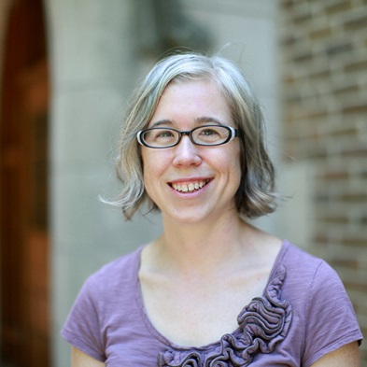
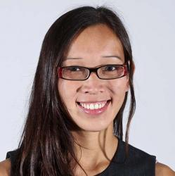
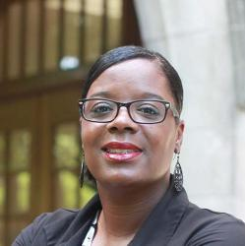
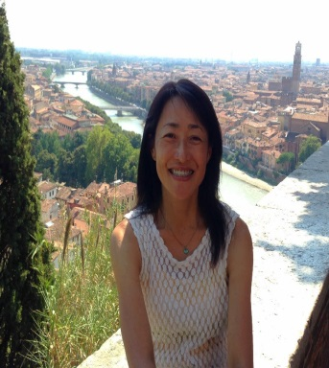
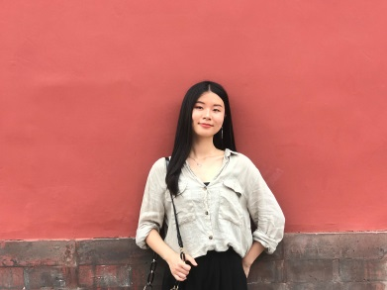
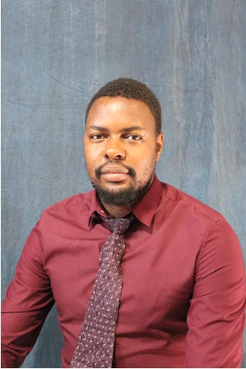
Members of the Learning Commons Family
Lucas Street, Director of RWC
Dr. Jake Romaniello, ELL Specialist
Farah Marklevits, Assistant Director of RWC
Yen Dao, Director of Students Success Services
Kam Williams,
Director of Disability
Services
Miyuki Komura
Genesis Li
Tatenda Nyoni

Slide 8
Learning Commons: Academic Support Services for Everyone
Located on the 3rd and 4th floor of The Gerber Center
Office of Disability Services
Reading/Writing Center
Student Success Services

Slide 9
Reading/Writing Center
Improve reading and writing skills
Improve English language skills
Free to all students
Hours available during the day on M-F and evenings times during M-TH and Sun.
Staffed by 25 peer tutors and 3 faculty tutors
30-45 minute sessions with peer or faculty tutors.
No paper yet? No Problem!
Personal Statements and Cover Letters

Slide 10
Subject Tutoring
Over 90 peer tutors hired and trained
Drop-in Tutoring Subjects: Math- Precalc/Calc and El ED, Computer Science, Chemistry, Physics, Business Stats, Economics, Accounting, Graphic Design, Latin & Greek.
100 and 200 levels
All students are welcome to participate!
Free to All students enrolled in these courses.
Come for 10 minutes or stay the whole hour.
Individual Tutoring:
Free to students receiving C or below in the course
Submit a request through Starfish
Professor verification of grades
1-2 hours a week, as needed
Submit requests early!

Slide 11
Study Skills Workshops
Free and all are welcome to participate
45-60 minutes each:
Procrastination: Due Today Doesn’t Mean Do Today
Secret Formula to Math and Science
Stress Management: Mindfulness and Walking Meditation
Civil Discourse: How do we talk about emotionally charged topics?
How to Survive Group Projects
Assertiveness and Negotiation
Effective Oral Presentations
Social Media and Self Promotion
Reduce Test-Anxiety with Effective Test Preparation

Slide 12
One-on-One Study Skills Coaching
One time appointment to weekly meetings
Personalized session on any topic related to accomplishing one’s goals
Free to all students interested
Notes:
Should we remove the 2.5 hour session example to set realistic expectations?

Slide 13
Skills courses, Credit Bearing and Graded
Engl 101, Intro to College Discourse, recommended for first year students wanting to improve their reading and writing skills. 1 credit class that includes one-on-one tutorials with faculty and peer tutors.
Engl 102, Critical Strategies for College Discourse, recommended for sophomores and transfer students wanting to research in the liberal arts. 1 credit class in a guided independent study format.
English 110, Rhetoric and Culture of the United States, recommended for international students wanting to learn about local, national, and global culture and essential academic skills required to be a successful college student in the US and beyond. 4 credit class that meets MWF 3-4:15pm in Fall semester.
LSC 199, College Experience & Success, recommended for first year students wanting to improve their study skills. 1 credit class that meets MW 9-10:15am for 7 weeks in the first half and second half of Fall semester. It’s offered in the second half of Spring semester.

Slide 14
Student Success
Students must seek help and respond to assistance.
Students must check and respond to emails on a regular basis.
It is okay to alert us that your student is struggling. However,…
The student must fill out a FERPA Release of Information form in the Registrar’s Office to give permission to that specific staff member to speak with the family member.
Encourage students to share their knowledge by becoming a tutor or workshop presenter.

Slide 15
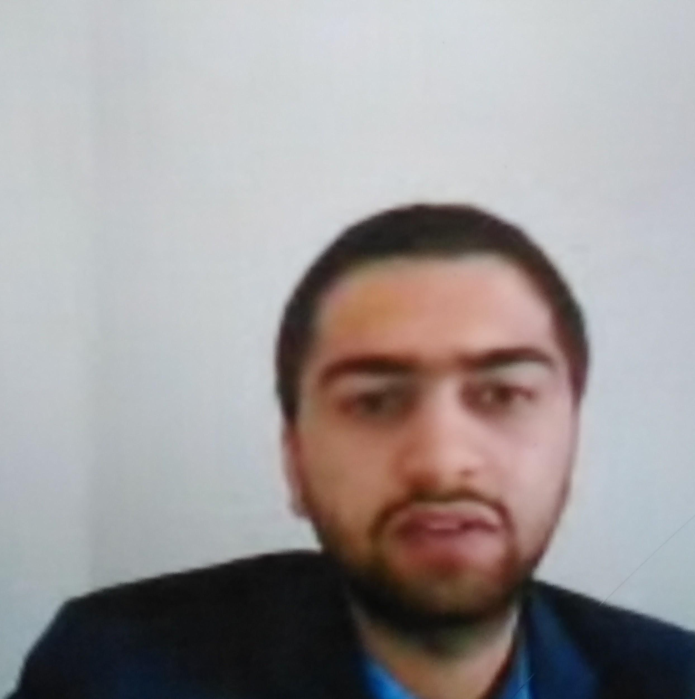
Like Omid Barikzay…
Omid was a math tutor at Augie. Then he served as a panelist for our Civil Discourse Panel and Practice in 2019.
Most recently, Omid impersonated Former Vice President Joe Biden in our first Mock Presidential Debate this year done via live video chat.

Slide 16
Academic Support Services: Disability Services
Ms. Kam Williams
Director of Disability Services - Learning Commons
kamwilliams@augustana.edu

Slide 17
Academic Accommodations for Students with Disabilities
Registering with the Office of Disability Services:https://www.augustana.edu/student-life/residential-life/disability-services
Current documentation from(a licensed professional, doctor, therapist etc.).
Current IEP/504 documentation also acceptable.
Submit the Accommodations Request Form on our website.
Documentation can be mailed, faxed, emailed, or uploaded through acc request form.
Director of Disability Services will contact student for a face to face to discuss appropriate academic accommodations to assist in student success.
Student will meet privately with each professor and discuss accommodations. Student will continue to advocate throughout semesters.
Student is responsible to contact ODS, schedule an appointment as part of the process in registering with Disability Services.

Slide 18
Counseling Services
Dr. William Iavarone
Director of Student Counseling Services
williamiavarone@augustana.edu

Slide 19
Location: Founders 206
Second floor
(Directly above
The Dean of
Students office)

Slide 20
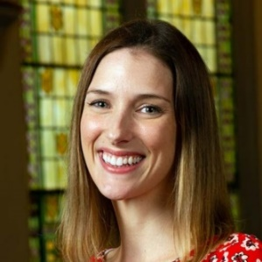
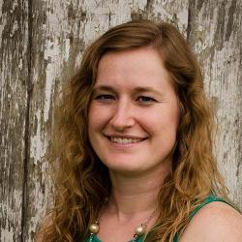
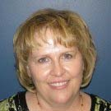
Staff Personnel
William Iavarone, LCPC (Director of Counseling)
Allison Mirell, LCSW (Student Counselor)
Alyssa Matz, LCPC (Student Counselor)
Cheri Mizaur (Counseling Service Assistant )

Slide 21
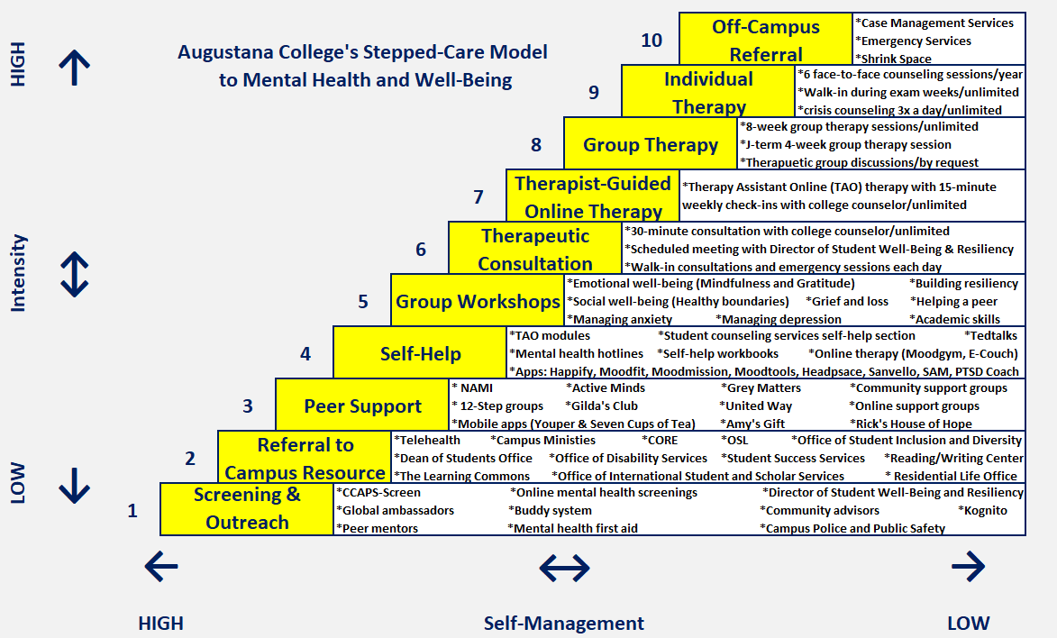
Mental Health Delivery Model

Slide 22
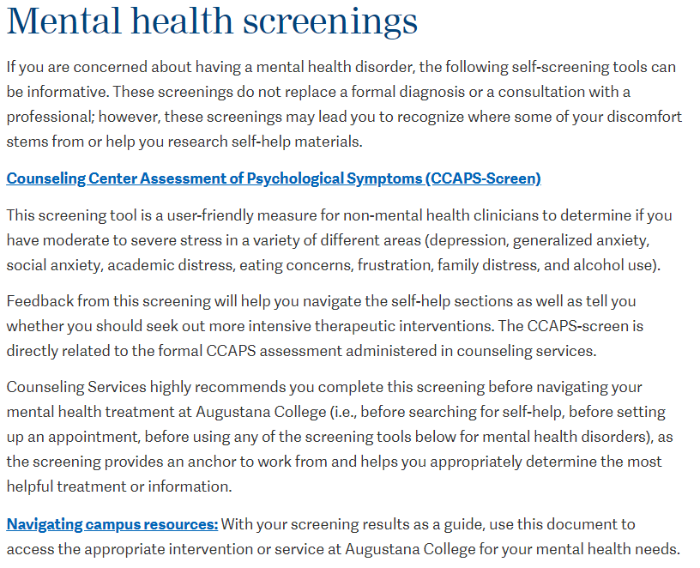

Slide 23
Kognito

Slide 26
Life satisfaction
Cultivating happiness
Resilience 101
Helping a struggling peer
Student success and engaging college
Social well-being
Assertiveness
Healthy boundaries
Active Listening
Emotional well-being
Mindfulness
Emotional regulation
Practicing gratitude
Psychological well-being
Grief and loss
Managing anxiety
Managing depression
Notes:
B1. These workshops are not process-oriented groups, so you will not share personal experiences or work through your current life stressors (like in group counseling); rather, these workshops teach you strategies to relieve your distress and maintain a healthy lifestyle.
B3. An email blast is sent out bi-weekly to discuss the upcoming topics for the next two weeks to all students.

Slide 27
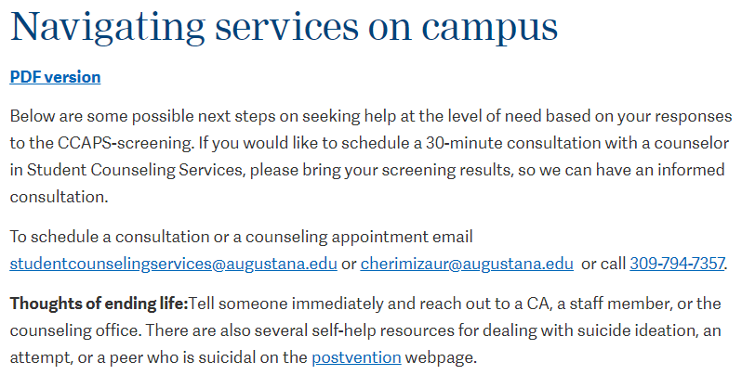
Counseling Center Assessment of Psychological Symptoms (CCAPS):
Depression
Generalized anxiety
Social anxiety
Academic distress
Eating Concerns
Frustration
Family Distress
Alcohol Use
Suicidal/homicidal ideation

Slide 29
Our Group Counseling Mission:
We strongly recommend group counseling as a treatment intervention, because we believe in the power of immediate peer feedback in a safe, therapeutic environment, moderated by trained therapists.
Purpose of Group Counseling:
The group process is a particularly rewarding therapeutic experience, as the process shows you are not alone and that you can give and receive meaningful support to others.
Typical course of treatment:
7 Sessions (with a total of 14 sessions a semester)
Notes:
B2. Sometimes, you may be referred to both group and individual counseling sessions to process your group experience privately or to work on sensitive topics outside of the group experience.

Slide 30
Short-Term Individual Counseling provides solutions and brief interventions for students adjusting to life’s stressors:
Relational difficulties
Stressors of college or independent living
Lapses in mental health management
Moderate/severe mental health symptoms
Typical course of treatment: 1-6 sessions
Crisis Counseling
Emergency sessions are available on a first-come, first-serve basis during the hours of 11:00-12:00 pm or 3:00-4:00 pm.
No prior appointment necessary
Walk-in Sessions
During week 7 and week 15 (final exams)
No prior appointment necessary

Slide 31
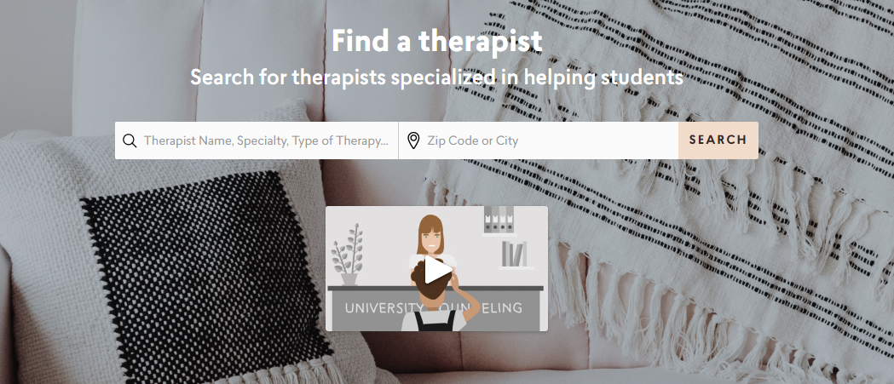
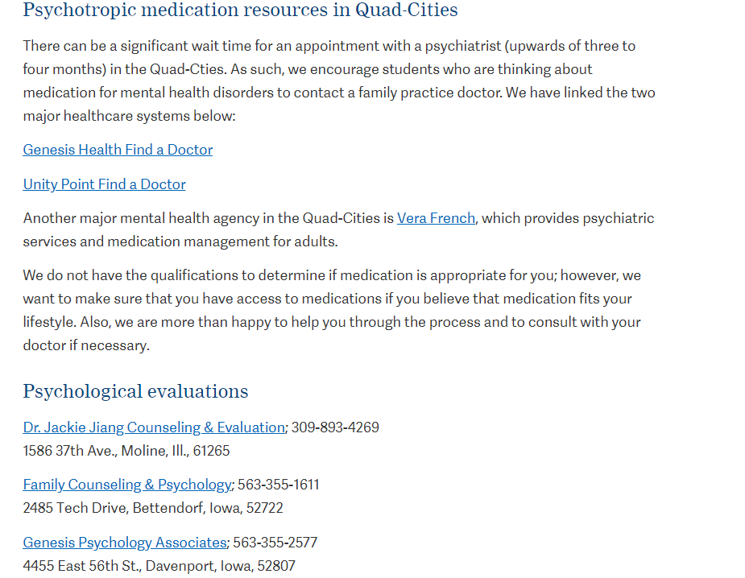
Community Therapist Referral (Shrink Space)
Case Management Services
Psychological evaluations
Academic accommodations
Emotional support services
Specialized treatment
Notes:
We refer to provide you with the best possible care while you attend Augustana College.
Augustana College also provides a variety of transportation options to medical and mental health appointments. We are happy to discuss those options with you at any time
If you present with a mental health need that requires outside services, either as a supplement to campus counseling services or as a primary service, we will refer you to treatment in the Quad-Cities.

Slide 32
Notes:
Think of just 9, and after 6 sessions of individual and 3 sessions of Telecounseling, a student is ready to either step-down or may need to step-up our care model.

Slide 33
An Important Ratio
5 to 1
Notes:
When you think about the people you interact with daily, it is important to realize that if they say something that you perceive is negative, it will take three positive experiences to change your view of them. Now, when you think of the people you have intimate and close relationships with (best friends, families, etc), the ratio is even higher. It is 5 to 1.
So, parents, for every one negative comment you say that your children take as a criticism, you will need to say 5 positive things to negate that criticism and keep a healthy relationship.
Incoming freshman, when you think about the way you think about yourself, you have to realize that for every one self-criticism, you need to have 5 positive praises to negate your criticism and think positively about yourself.
Of course, this is not an instantaneous system, where the exchange is an immediate transaction, but when you think about the people you have positive relationships with, it is most likely because they lift you up at a ratio of at least 5 to 1.

Slide 34
Mr. Tom Phillis
Chief of Police and Public Safety
tomphillis@augustana.edu

Slide 35
What’s the Rock Island neighborhood like?
Common crimes in the area
Working relationship with Rock Island Police Department

Slide 36
Keeping students safe is our #1 priority
Hybrid office of police and public safety officers
Patrols on campus
Common crimes
Theft-vandalism – LOCK YOUR DOORS!
Dispatch center
ACES

Slide 37
Emergency Preparedness
2 drills + 1 full-scale exercise every year
Emergency notification systems
Certifications
Ready to Respond Campus (Illinois Emergency Management Agency)
Weather-Ready Nation Ambassador (NOAA)

Slide 38
Dean of Students Office
Ms. Laura Schnack
Associate Dean of Students
Lauraschnack@augustana.edu

Slide 39
Conduct
Community Principles
Accountability, Care, Openness & Respect, Purpose, Responsibility
Approach is a combination of education and financial consequences
Parental involvement

Slide 40
AlcoholEdu & Sexual Assault Prevention Modules
Community Principles
Accountability, Care, Openness & Respect, Purpose, Responsibility
2, two-part interactive online modules
Access will be given in July
Part 1 completed prior to arriving for Welcome Week
Engage your student in conversations about these topics
What are your expectations around alcohol, drugs and healthy relationships?

Slide 41
Class Absences & Support
Communication is KEY
Anticipated absences vs. unexpected absences
Short-term absences vs. long-term absences
Documentation and verification process

Slide 42
Medical Services
Ms. Michelle Mason
Assistant Director of Residential Life
michellemason@augustana.edu

Slide 43
Medical Services
UnityPoint Express Clinic 2 miles from campus
2 Hospitals within 4 miles of campus
www.augustana.edu/student-life/health-care
Transportation to
Medical Services:
College Health Care Shuttle, 309-781-5711
Lucky Cab Co., 309-788-8182

Slide 44
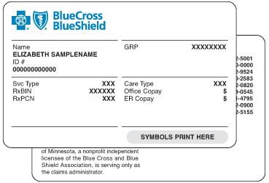
Pharmacies
Walgreens (.5 miles)
HyVee (.6 miles)
CVS (.7 miles)
Jewel-Osco (1.7 miles)
Target (4.5 miles)
Walmart (7 miles)
Insurance
Check with your provider
Telehealth
Students should have an insurance card

Slide 45
Medical Accommodations
Housing Accommodation Request Due June 30
Form: augustana.edu/accommodations
Documentation

Slide 46
Non-Medical Transportation

Slide 47
Health Clinic
The clinic will be staffed by a Physician’s physician’s Assistant assistant with hours compatible to with student schedules.
Services plan to include treatment of sprains, strains, fevers, strep
throat testing, cold and flu treatment, pneumonia, minor fractures, lacerations, seasonal flu vaccines and other acute problems.
Medication, and additional tests may drive costs for a student and would be handled through the student’s insurance.

Slide 48
Health Clinic
In accordance with guidance from the CDC, American College Health Association and the Illinois Department of Public Health, planning and preparation is ongoing for the Health Clinic to assist the College in addressing COVID-19 concerns.

Slide 49
THANK YOU!
This presentation will be available on the Augustana Orientation webpage shortly.
In addition to contacting these presenters for more information, please feel free to continue directing questions to your student’s Admissions Counselor.
And please stay tuned as the College shares more plans for Fall 2020 as additional guidance from the CDC or other health experts becomes available.
GO VIKINGS!

